Slide 1
STEMworks Website

Slide 2
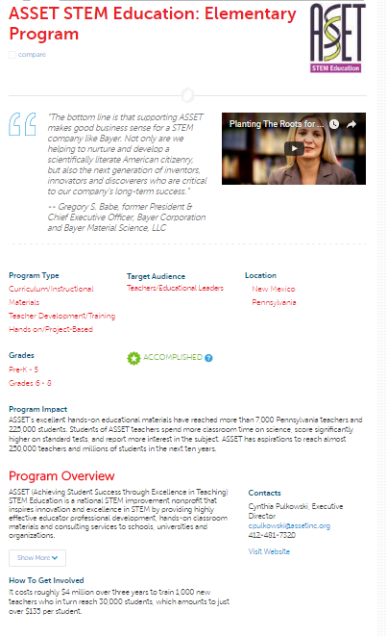
STEMworks Website

Slide 3
Rigorous Application Process

Slide 4
Rigorous Application Process

Slide 5
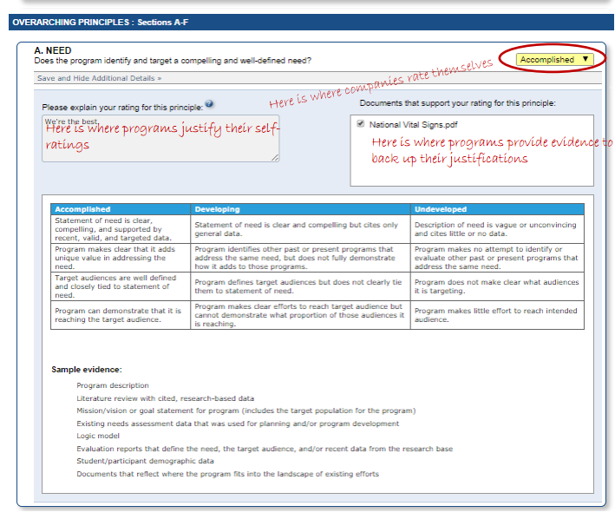
Notes:
Training for reviewers of state STEM programs
Online program application & review system
Reviews of the strengths & weaknesses of each program applicant
Flexibility to add state-specific review criteria
States select reviewers, who can either volunteer or be compensated.
Change the Equation and its contractor, WestEd provide two substantial virtual training sessions for state reviewers
Programs admitted through the review process will be added to the STEMworks database. The state can also promote successful programs on their own websites, if they choose.
States can add additional review criteria to the STEMworks review criteria, if they choose. The Iowa Governor’s STEM Advisory Council added criteria designed to assess programs’ capacity to expand within Iowa and to meet Iowa’s specific funding priorities, for example. Programs that receive funding must meet the STEMworks criteria and the Iowa-specific criteria to receive state funding for scaling.

Slide 6
Rigorous Review Process

Slide 7
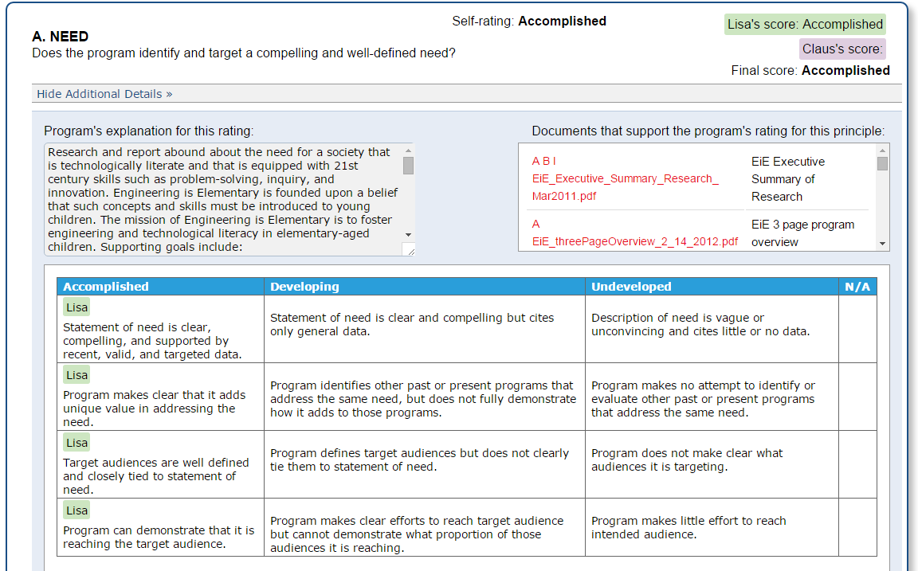
Notes:
Training for reviewers of state STEM programs
Online program application & review system
Reviews of the strengths & weaknesses of each program applicant
Flexibility to add state-specific review criteria
States select reviewers, who can either volunteer or be compensated.
Change the Equation and its contractor, WestEd provide two substantial virtual training sessions for state reviewers
Programs admitted through the review process will be added to the STEMworks database. The state can also promote successful programs on their own websites, if they choose.
States can add additional review criteria to the STEMworks review criteria, if they choose. The Iowa Governor’s STEM Advisory Council added criteria designed to assess programs’ capacity to expand within Iowa and to meet Iowa’s specific funding priorities, for example. Programs that receive funding must meet the STEMworks criteria and the Iowa-specific criteria to receive state funding for scaling.

Slide 8
Rigorous Review Process

Slide 9
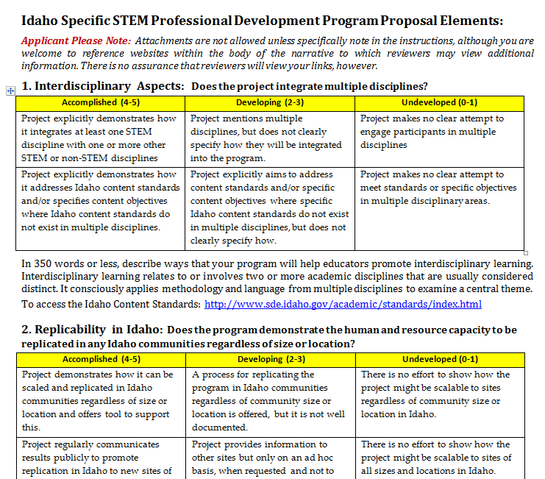
States can add their own questions

Slide 10
What state partners provide
Reviewers who dedicate time to program reviews (Ca . 2 hours/ program)
Someone to coordinates reviewers
Outreach to STEM program providers in the state
Agreement not to alter the STEMworks review principles

